Slide 1
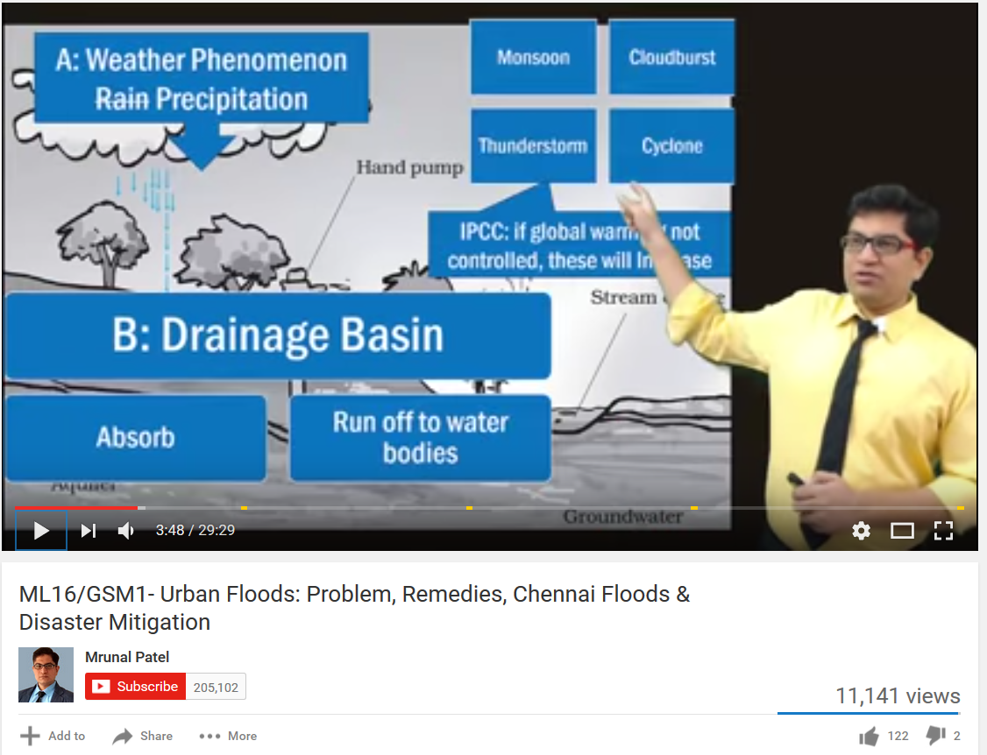
After the successful completion of ML16
Because Chest thumping and Bogus marketing propaganda is ESSENTIAL…
UPSC Civil services Mains 2016
(GS1) Major cities of India are becoming more vulnerable to flood conditions. Discuss.
(GS3) The frequency of urban floods due to high intensity rainfall is increasing over the years. Discussing the reasons for urban floods. highlight the mechanisms for preparedness to reduce the risk during such events.

Slide 2


B-ES-17
Now starting the new season…
Careful when you write in mains…it’s not Survey 2017
Download PDFs from
http://indiabudget.gov.in
Budget highlights | survey (Hindi / English)

Slide 3
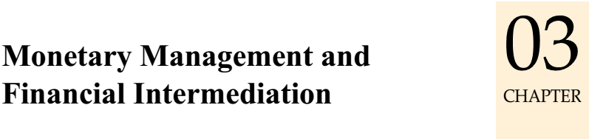
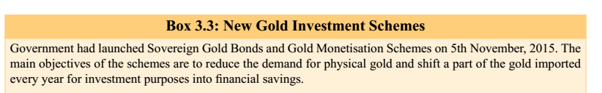
UPSC prelim CSAT 2016
What is/are the purpose/purposes of Government’s ‘Sovereign Gold Bond Scheme’ and ‘Gold Monetization Scheme’? 1. To bring the idle gold lying with Indian households into the economy 2. To promote FDI in the gold and jewellery sector 3. To reduce India’s dependence on gold imports Select the correct answer using the code given below.
(a) 1 only (b) 2 and 3 only (c) 1 and 3 only (d) 1, 2 and 3

Slide 4
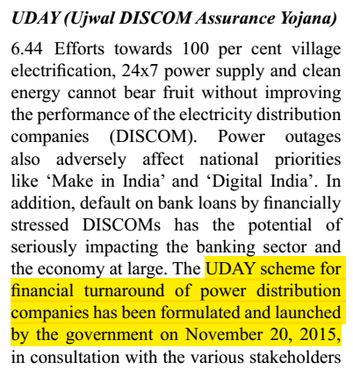
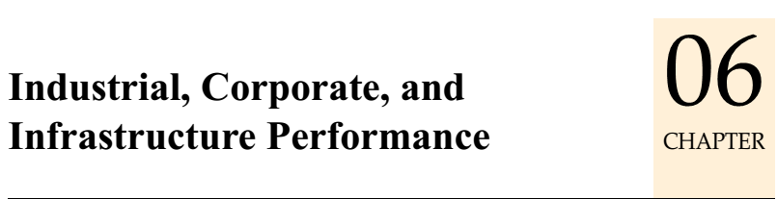
UPSC prelim CSAT 2016
Which one of the following is a purpose of `UDAY’, a scheme of the Government? (a) Providing technical and financial assistance to start-up entrepreneurs in the field of renewable sources of energy (b) Providing electricity to every household in the country by 2018 (c) Replacing the coal-based power plants with natural gas, nuclear, solar, wind and tidal power plants over a period of time (d) Providing for financial turnaround and revival of power distribution companies

Slide 5
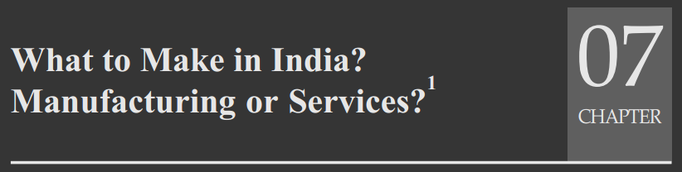
UPSC GSM3-2015 (DEC)
The nature of economic growth in India in described as jobless growth. Do you agree with this view? Give arguments in favour of your answer.

Slide 6
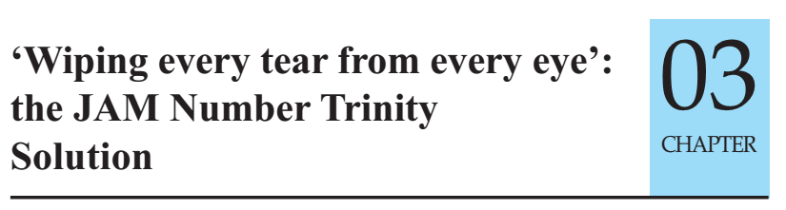

UPSC GSM3-2015 (DEC)
In what way could replacement of price subsidy with Direct Benefit Transfer (DBT) change the scenario of subsidies in India? Discuss.
All chapters I shall cover, but read every chapter’s italics introduction and conclusion for answer writing.
No harm even for doing 2014,15,16
http://indiabudget.gov.in

Slide 7
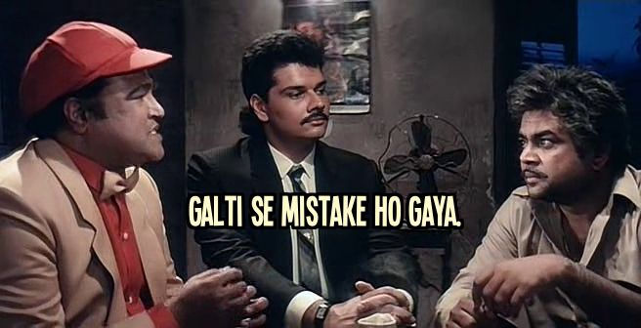
B-ES = Prelim cum Mains… prepare ‘pickle’ only once a year
PRE ’17
Factual, Objective type survey
Mains’17
Pass – won’t have time
Fail won’t analyze paper or survey
Pre’18
Analysis later for Mains
BES17 no longer priority
FAIL
…..cycle

Slide 8
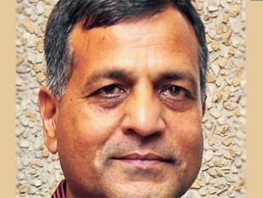
B-ES: Who prepares what (2017)?
Finance Min.
Economic Affairs (Shantikanta Das)
Expenditure (Ashok Lavasa)
Revenue (Adhiya)
Financial services
Department Investment & Public Asset Management (DIPAM)
Eco. Survey (31Jan) Chief Eco. Advisor
Budget (1Feb)
Finance Secretary : senior most Secretary among 5 Departments
Signs one rupee note.

Slide 9
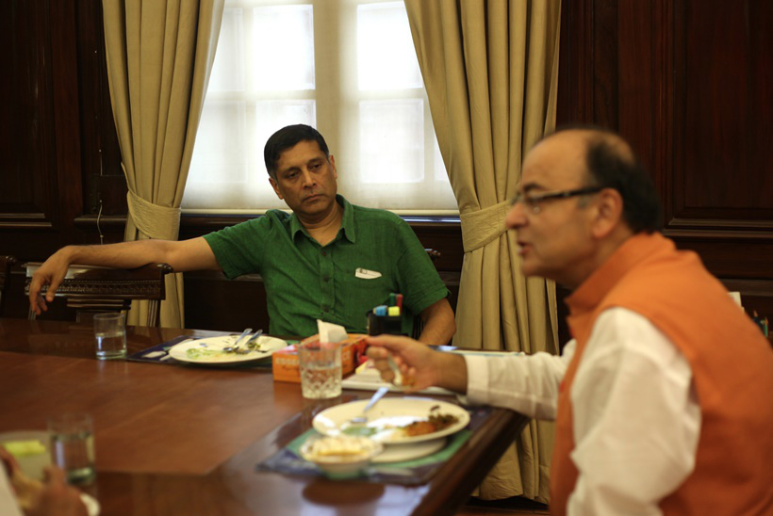
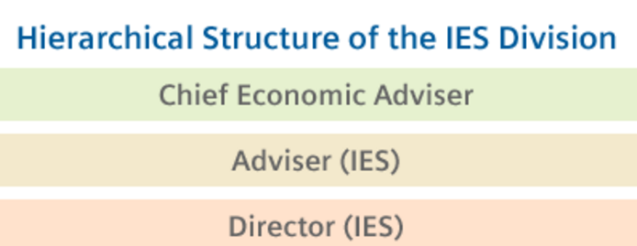
Economic Survey: the making of
CSO
Chief Eco. Advisor to FM
Department of Economic Affairs
Ministries, Experts
Finance Secretary
Parliament Oxford authorized for hardcopy. amazon piracy
Finance Minister Jaitley first time authored a section
Notes:
senior most among 5

Slide 10
2013-14
1 Vol: 13 ch+1 statistical appendix
2014-15 (Two Volume System like “IMF’s World Economic Outlook”)
Vol1: future | Vol: 2 Past data
2015-16
2016-17 (14 chapters)
Vol1. | Vol2 later on
No theme in PDF: med. Term eco future = special challenge.
Theme: Creating opportunity and reducing vulnerability: JAM, Jeans
Vol1: future | Vol: 2 Past data
No theme in PDF: TBS-4D, Reg. Cholesterol, JAM-BAPU

Slide 11
Economy: 6 Pillars (Theory + Current + BES17)
1.Banking
6.HRD
3.BoP
4.Sectors
5.Infra & Env.
Micro, inflation, GDP
2.Budget
but first a gist of all 14 chapters of survey, to handle
upcoming exams interviews before series is over

Slide 12
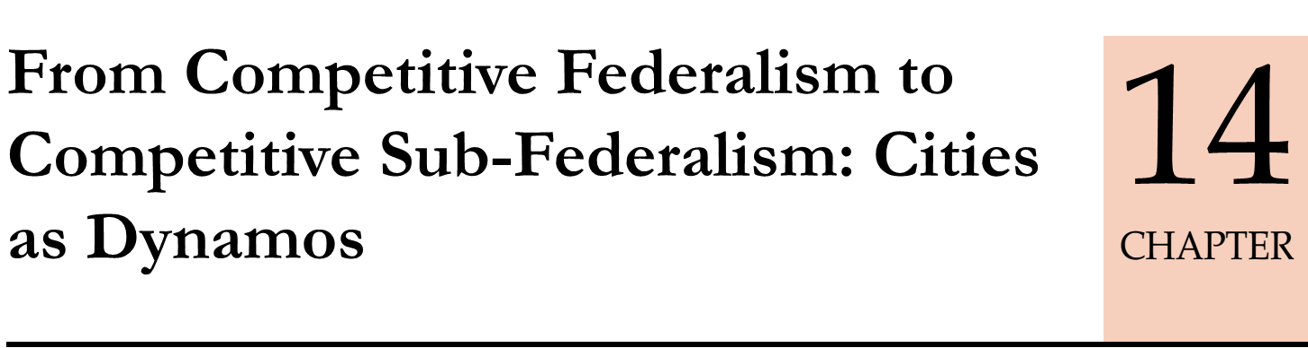
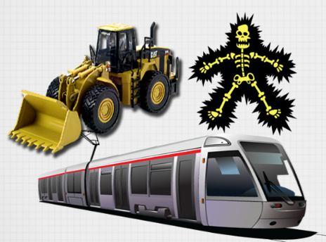
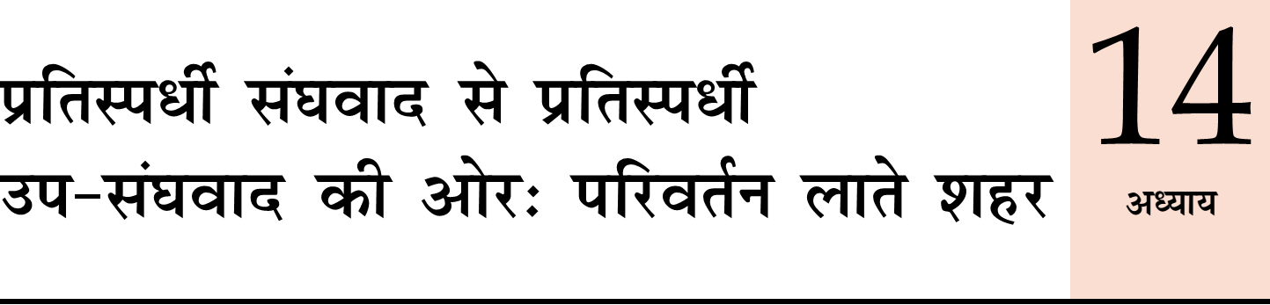
Tata Nano: W.Bengal ->Gujarat
Property tax 5-20% of actual potential->financially weak ULBs
Large migration
Notes:
Raje taking labour reforms.
Vibrant summits everywhere.

Slide 13
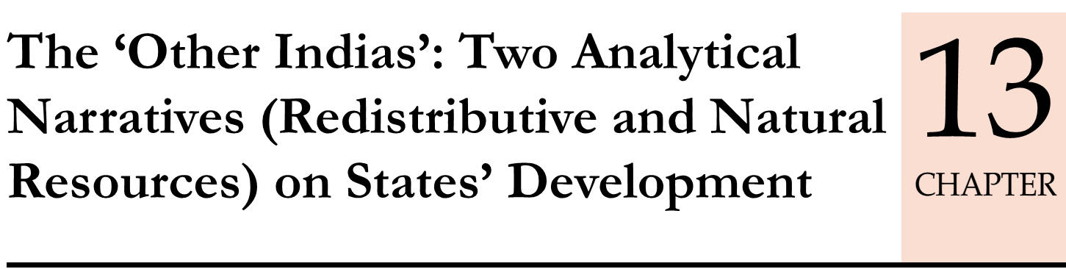
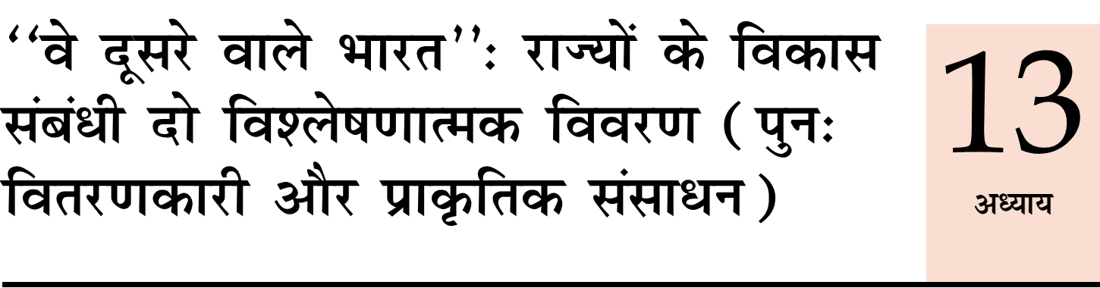
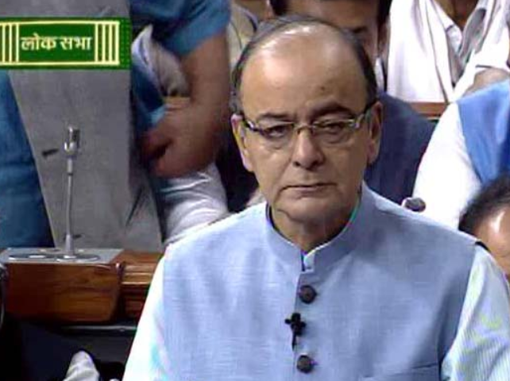
Coastal states: rich & developed
NE, hill states, Sp.Cat: FC resource transfer ▲= Eco.dev▼ coz Tax structure.
Mineral rich states: GSDP ▲ but poverty & inequality ▲coz governance structure poor.

Slide 14
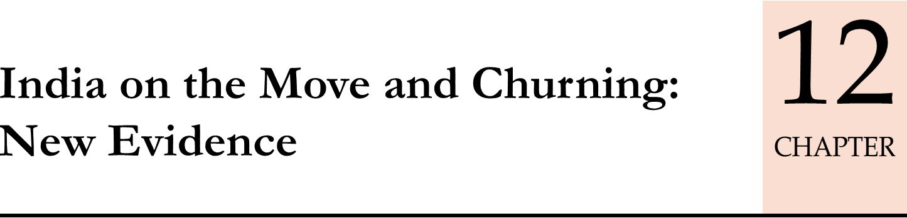
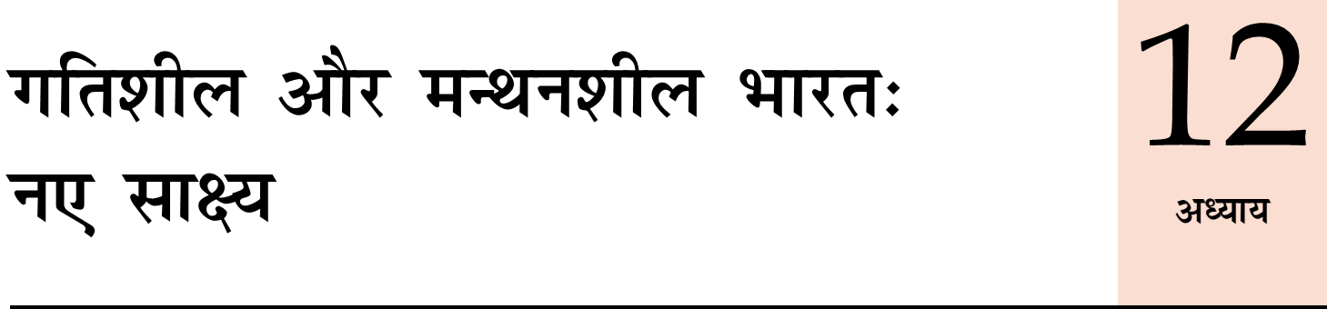

China: interior -> coastal migration ->remittance, investment =inequality ▼
India: migration ▲ than expected: ~50-90 lakh PA [Railway + census big data analytics]
Domestic remittance: 1.5 lakh cr. /PA
Yet inequality ▼? …x
Financial inclusion, governance structure
Notes:
From railway and census data
Not attracting capital.

Slide 15
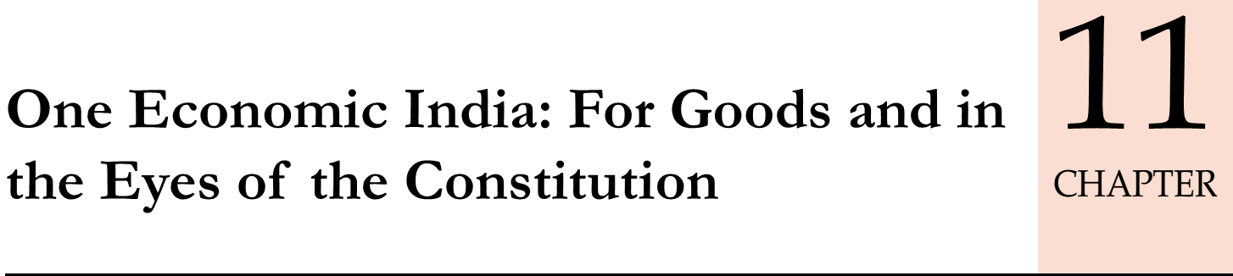
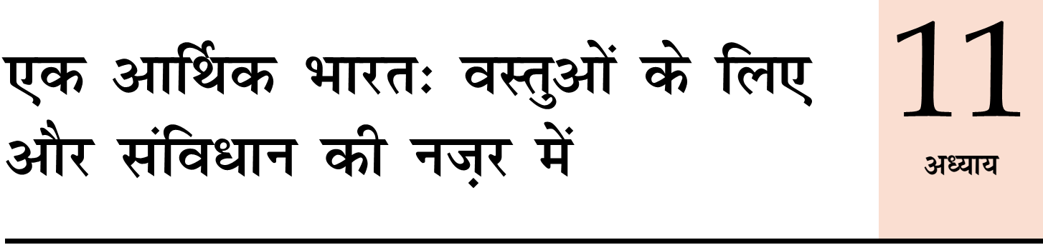
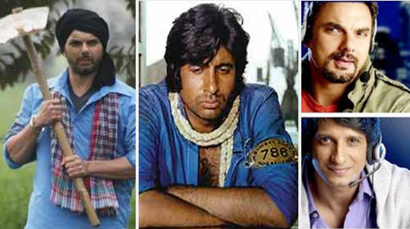
Constitution: one Territorial India..☺
Freedom of trade and commerce..☺
One economic India: 1 registration, 1 Tax, 1 Rate, 1 Form… ☹??
Both union + states can impose restrictions-> Barriers to internal trade: APMC, CST-VAT exemptions & cat.
Even US / EU states don’t have

Slide 16
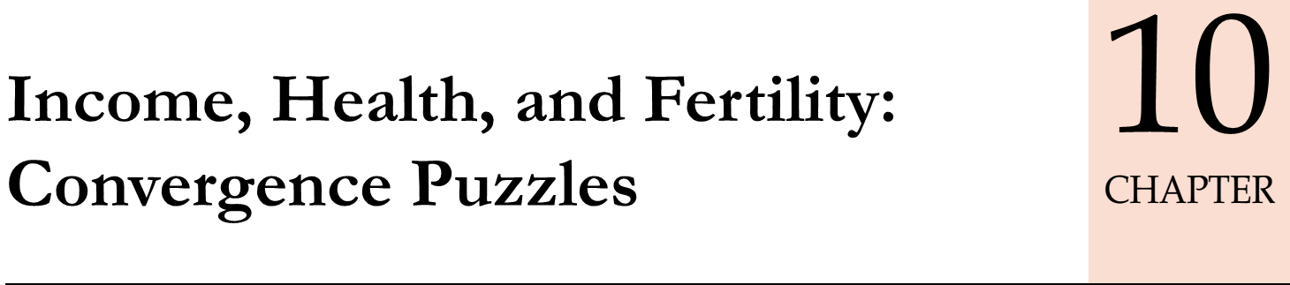
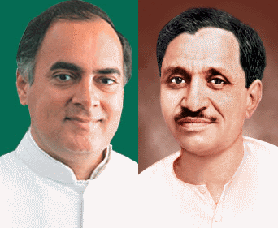
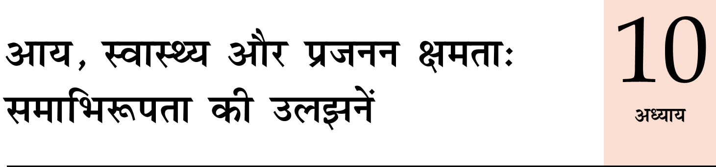
Health: Life Expectancy ▲☺, Fertility rate ▼ ☺, IMR ☹
goods + men moving fast, GSDP ▲☺ but Income inequality ☹…??
Poor states: poor governance, brain drain, remittance ☺ but investment ☹

Slide 17

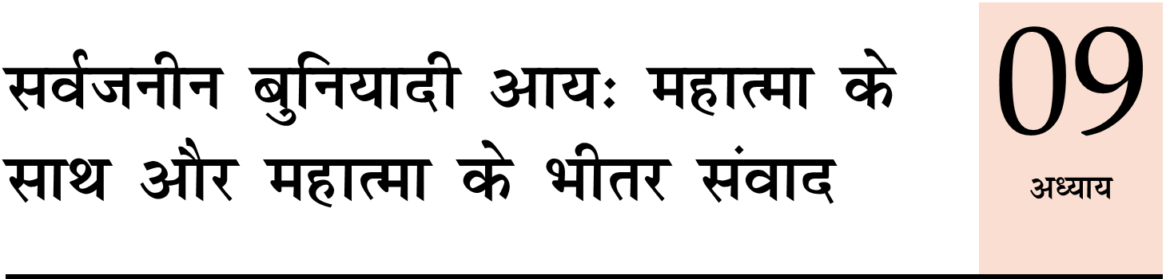
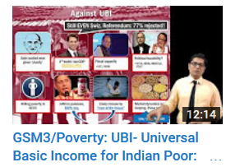
Can’t implement @once, but discuss seriously
Poorest districts: Governance poor, leakages are high->poor getting very less.
Pros, Cons, preconditions
41 pages bolbacchan..
2 pages listing only references

Slide 18
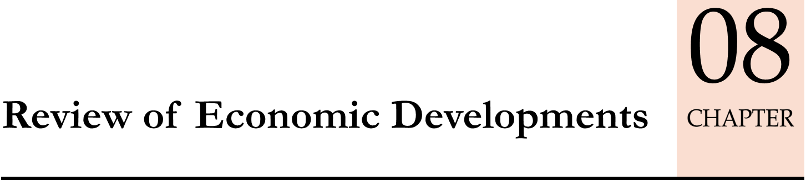
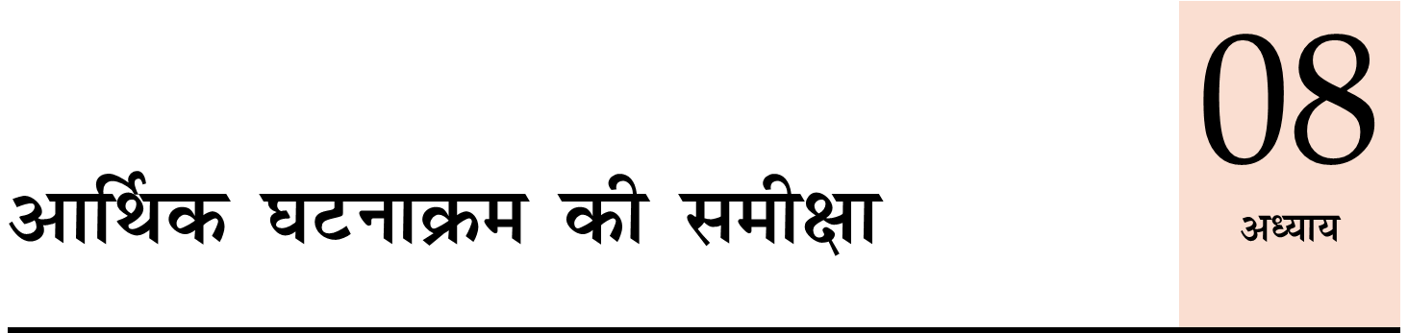
Spread across 6 pillars
6 pillars: Data & developments in last year
GDP, IIP, CPI, ease of doing biz, poverty, unemployment rates, climate change deals….

Slide 19
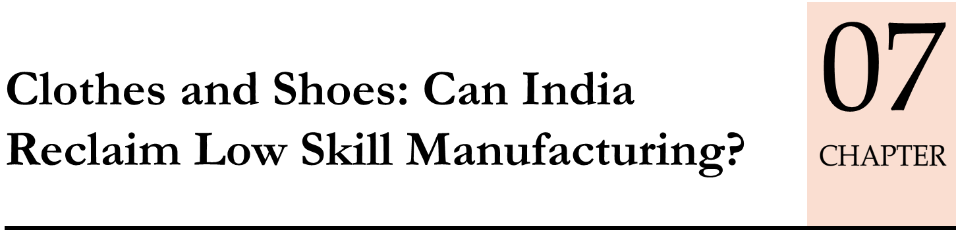
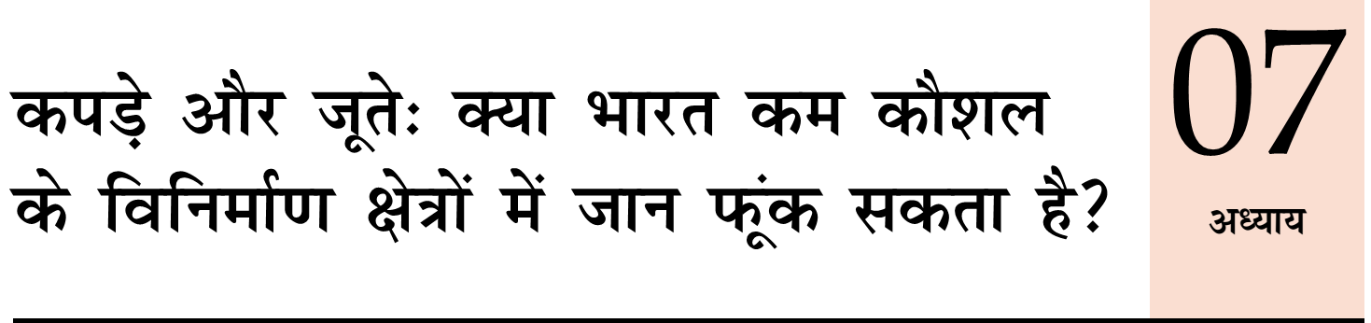
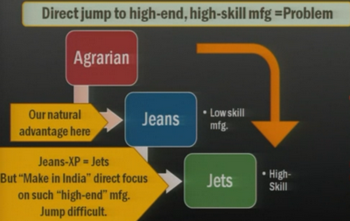
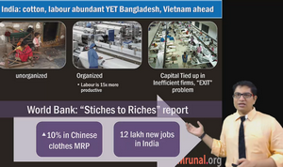
China: Rising wages. Mfg moving towards East Asian economies.
India: low skill textile & shoes, women
Problem: infrastructure,
tax structure, labour laws

Slide 20
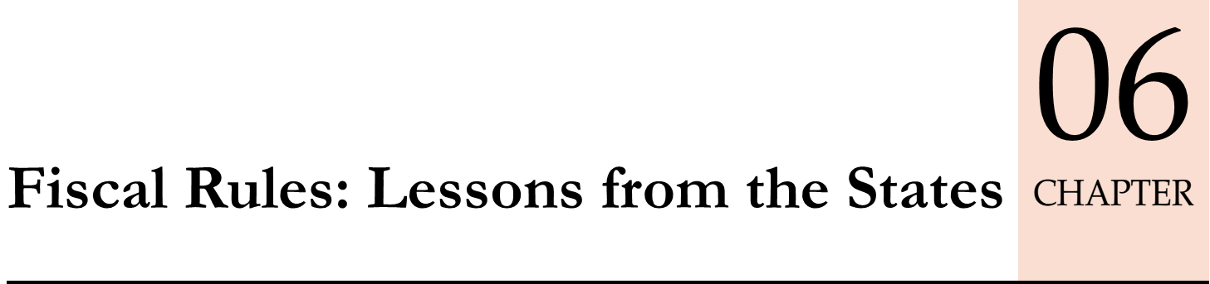
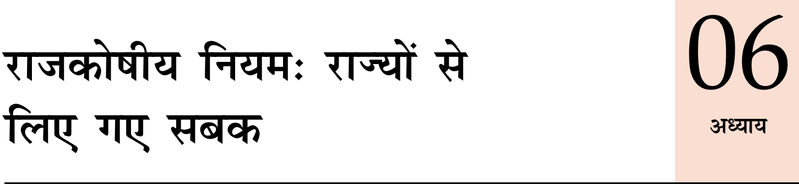
FRBM Act’03: FD 3%, ERD: 0%
States achieved
but problems ahead: 7th PC, UDAY Bonds….resentment over “Centrally imposed prudence”.

Slide 21
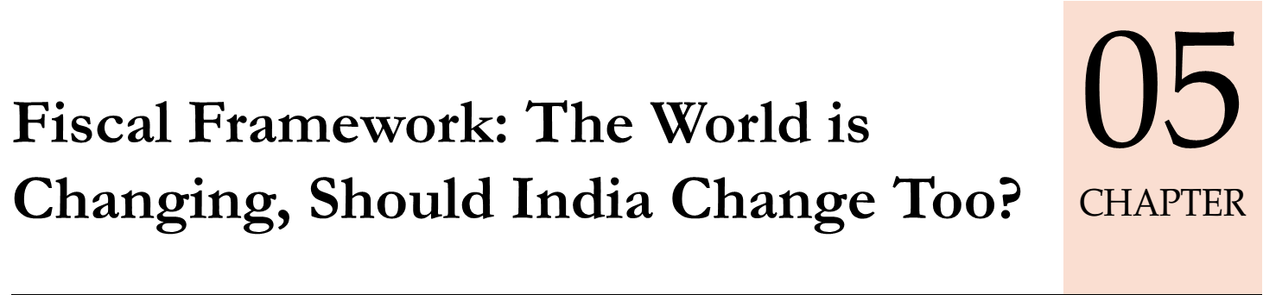


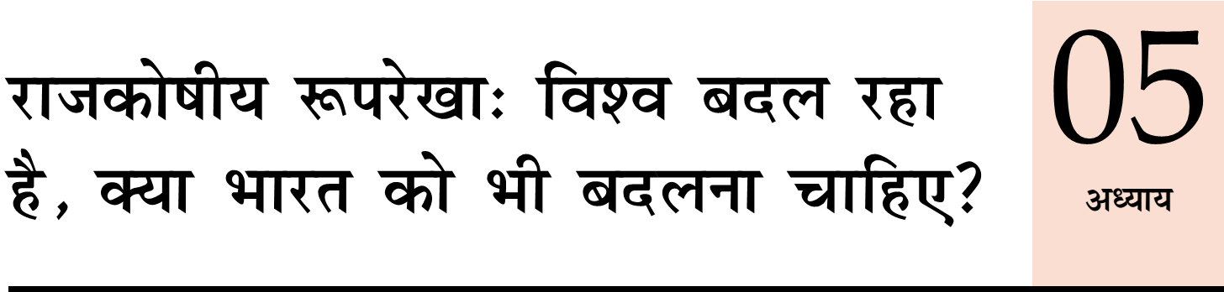
Post-GFC: 0% interest, “Fiscal activism”, “counter cyclic policy”-> GDP ▲
India can’t follow 1) inflation 2) TBS/NPA 3) Fiscal deficit -> crisis 1991, 2013.

Slide 22
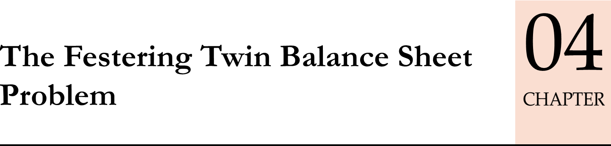
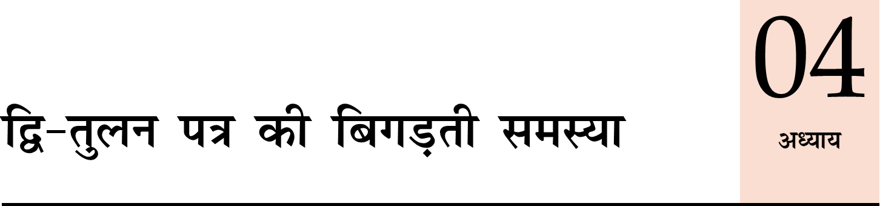
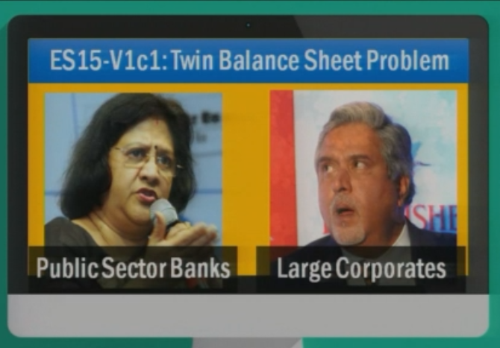
NPA grim picture, why can’t recover?
Events leading to TBS, how it has hurt whole economy?
Public Sector Asset Rehabilitation Agency (PARA): Why & How?

Slide 23
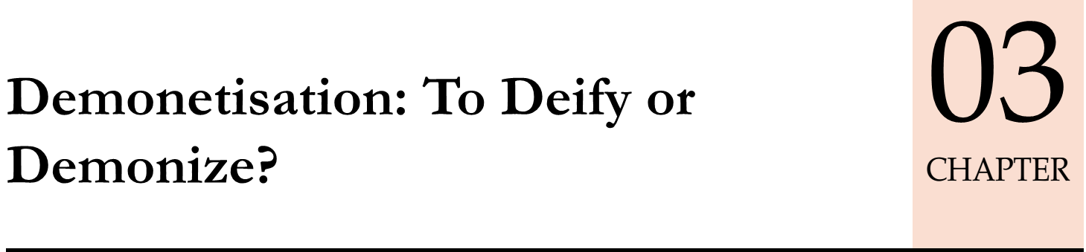
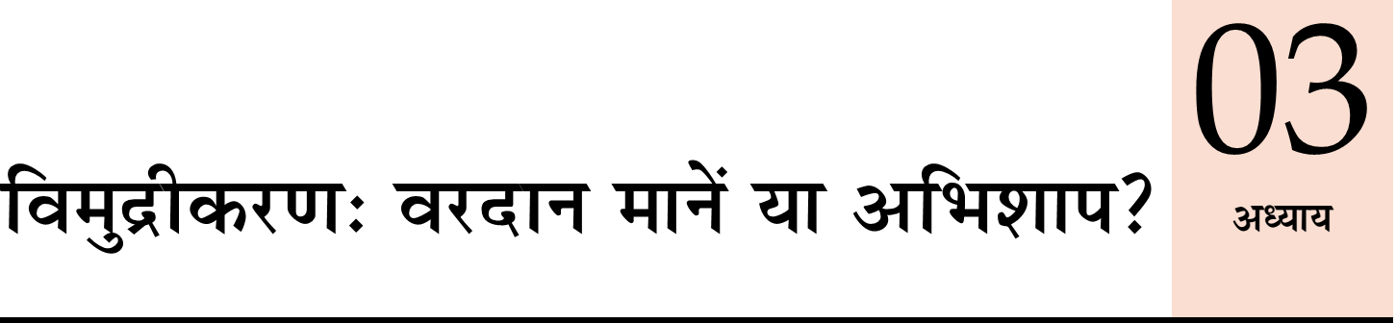

Was it right decision? Currency: GDP, soil rate…
Short term problem: GDP growth. How to address?
long term benefits…black money, financial inclusion, digital payment, real estate…How to reap maximum?
Chronology of past

Slide 24
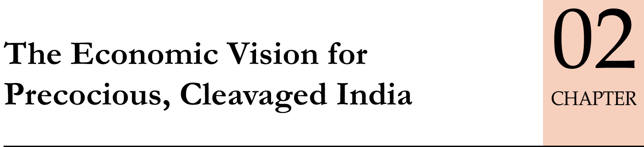
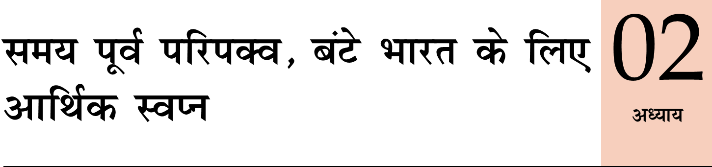
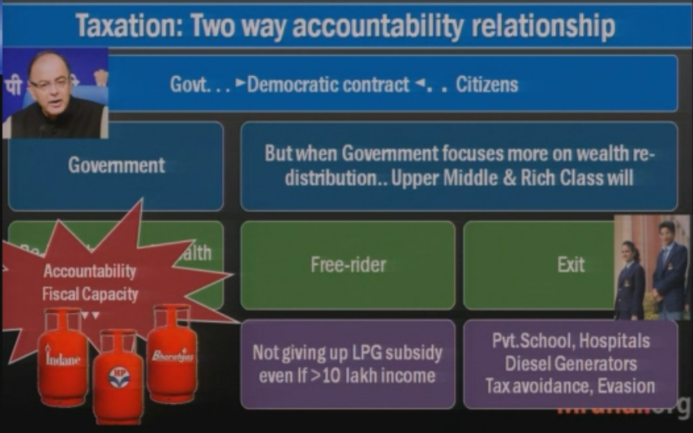
Proof: we are an Emerging Economy (4 measures) but growth model different than others hence bottlenecks- Kisan debt waiver, GST oppose, or privatizing loss making PSU/PSB...Why?
Precocious: Democracy voting rights to all.
Cleaved: middle class “exit” / “free-rider”

Slide 25
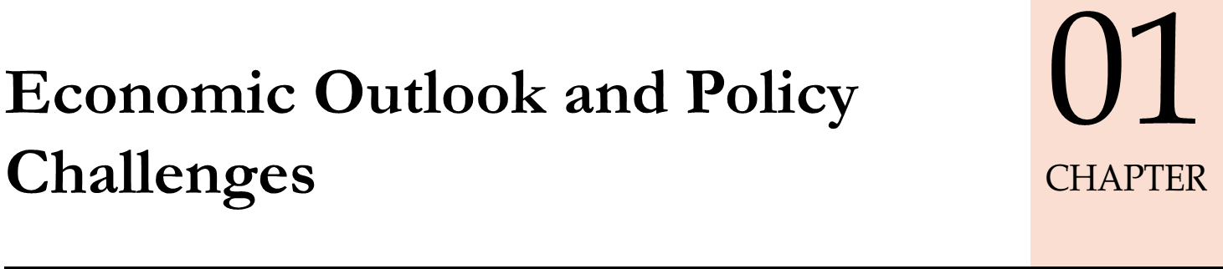
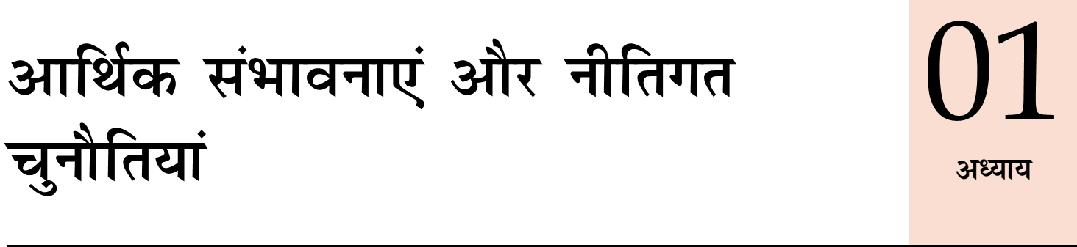
Spread across 6 pillars
Similar to ch.8 (review of eco. Dev)
Projections for 6 pillars: ….GDP, IIP, CPI, ease of doing biz, poverty, unemployment rates, climate change deals….
Notes:
Summary of the chapter 2 to 14.

Slide 26
Economy: 6 pillars + theory + current + BES17 (pre cum Mains)
1.Banking
6.HRD
2.Budget
3.BoP
4.Sectors
5.Infra
V1:c3,4
V1:c2,3,5,6,9,11(GST),12,13
V1c:5
V1c:7,11(Agri)
V1c:10
v1c:12, 14; Budget^Rail
Vol. 1 Ch. 1 and 8 spread throughout
Homework: budget highlights http://indiabudget.gov.in

Slide 27
Mock Question
Q1. Which of the following is / are unique about Economic Survey 2016-17?
Only one volume was published before budget 2017-18
First time, Big data analytics have been used.
First time, Union finance minister has authored a section in the survey.
Mentioned the circulation of pirated copies of survey on amazon.
Highlighted medium term economic future as special challenge.

Slide 28

Bankruptcy = is opportunity for us
B-ES
UPSC-2013 Mains GS expand-> Qbank bankruptcy. Same topics rephrased and recycled between Essay & GS.
Survey-2014-16: 2 volume -> bankruptcy of ideas…JAM, TBS/NPA, voters vs tax payers, GST, labour reform, boost infra investment- deepen capital market,
Latest survey: to prove simply hypothesis- giving large datasets, coefficient, models, formulas…observation >> policy prescriptions.
Opportunity: more time for other topics, Consolidate Knowledgebase

Slide 29
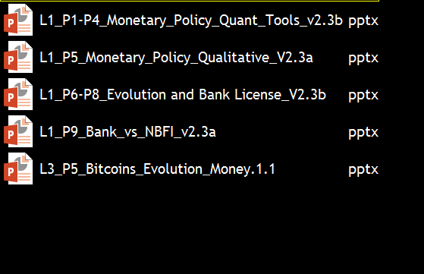
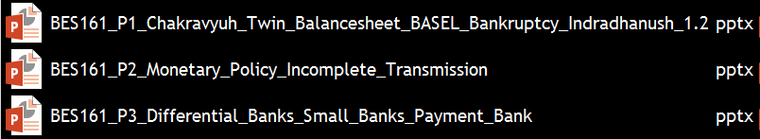

Survey= bankruptcy of new ideas; my PPT suffering ‘fragmentation’
Evolution: BMB-> merger with SBI
Small bank payment bank. Scattered
FI classn: Mudra Bank?
Monetary policy: rules, MPC, transmission Scattered
BES17 = “decontentization” of previous “SEASONS”
I’m going to utilize the time & opportunity to consolidate content for more revision friendly for future exams. In other words, what I teach in purple shirt = IGNORE previous PPT/lecture/article of that topic.

Slide 30
Economy: 6 pillars + theory + current + BES17 (pre cum Mains)
1.Banking
6.HRD
2.Budget
3.BoP
4.Sectors
5.Infra
V1:c3,4
V1:c2,3,5,6,9,11(GST),12,13
V1c:5
V1c:7,11(Agri)
V1c:10
v1c:12, 14; Budget^Rail
From next episode….will start from here.

